Slide 1
Primary Pulmonary Hypertension
Dr. P. R. Sisir

Slide 2
Primary pulmonary hypertension is characterized by pulmonary vascular obstructive disease and right-sided heart failure. It occurs at any age, although in pediatric patients the diagnosis is usually made in adolescence.
Some patients have evidence of either an immunologic disorder or a hypercoagulable state.

Slide 3
Mutations in the gene for bone morphogenetic protein receptor-2 (BMPR-2, a member of the transforming growth factor-β receptor family) on chromosome 2q33 have been identified in patients with autosomal dominant familial primary pulmonary hypertension (known as PPH1).
This genetic variant demonstrates a female preponderance and is found in 60% of patients with a family history and up to 25% of patients with sporadic disease

Slide 4
Viral infection, such as with the vasculotropic human herpesvirus 8 (HHV8), has been suggested as a trigger factor in many patients.
Diet pills, particularly fenfluramine, have also been implicated.
Pulmonary hypertension is a common complication of sickle cell anemia and other hemolytic anemias.
In children, pulmonary veno-occlusive disease may account for some cases of primary pulmonary hypertension.

Slide 5
Before a diagnosis of primary pulmonary hypertension can be made, other causes of elevated pulmonary arterial pressure must be eliminated - like:
chronic pulmonary parenchymal disease,
persistent obstruction of the upper airway,
congenital cardiac malformations,
recurrent pulmonary emboli,
alveolar capillary dysplasia,
liver disease,
autoimmune disease,
and moyamoya disease).

Slide 6
Pulmonary hypertension places an afterload burden on the right ventricle, which results in right ventricular hypertrophy.
Dilatation of the pulmonary artery is present, and pulmonary valve insufficiency may occur.
In the later stages of the disease, the right ventricle dilates, tricuspid insufficiency develops, and cardiac output is decreased.
Arrhythmias, syncope, and sudden death are common.

Slide 7
WHO Classification of Pulmonary Hypertension
1 Pulmonary arterial hypertension (PAH) 1.1 Idiopathic (IPAH) 1.2 Familial (FPAH)
1.3 Associated with (APAH): 1.3.1 Connective tissue disorder 1.3.2 Congenital systemic-to-pulmonary shunts 1.3.3 Portal hypertension 1.3.4 HIV infection 1.3.5 Drugs and toxins 1.3.6 Other (thyroid disorders, glycogen storage disease, Gaucher
disease, hereditary hemorrhagic telangiectasia,
hemoglobinopathies, chronic myeloproliferative disorders,
splenectomy)
1.4 Associated with significant venous or capillary involvement 1.4.1 Pulmonary veno-occlusive disease (PVOD) 1.4.2 Pulmonary capillary hemangiomatosis (PCH)
1.5 Persistent pulmonary hypertension of the newborn

Slide 8
WHO Classification of Pulmonary Hypertension
2 Pulmonary hypertension with left heart disease 2.1 Left-sided atrial or ventricular heart disease 2.2 Left-sided valvular heart disease
3 Pulmonary hypertension associated with lung diseases and/or hypoxemia 3.1 Chronic obstructive pulmonary disease 3.2 Interstitial lung disease 3.3 Sleep disordered breathing 3.4 Alveolar hypoventilation disorders 3.5 Chronic exposure to high altitude 3.6 Developmental abnormalities
4 Pulmonary hypertension due to chronic thrombotic and/or embolic disease (CTEPH) 4.1 Thromboembolic obstruction of proximal pulmonary arteries 4.2 Thromboembolic obstruction of distal pulmonary arteries 4.3 Nonthrombotic pulmonary embolism (tumor, parasites, foreign material)
5 Miscellaneous: sarcoidosis, histiocytosis X, lymphangiomatosis, compression of pulmonary vessels (adenopathy, tumor, fibrosing mediastinitis)

Slide 9
Clinical Manifestations
The predominant symptoms include exercise intolerance and fatigability; occasionally, precordial chest pain, dizziness, syncope, or headaches are noted.
Peripheral cyanosis may be present, especially in patients with a patent foramen ovale through which blood can shunt from right to left; in the late stages of disease, patients may have cold extremities and a gray appearance associated with low cardiac output.
Arterial oxygen saturation is usually normal unless there is an associated intracardiac shunt.

Slide 10
Clinical Manifestations
The heart is moderately enlarged, and a right ventricular heave can be noted.
The 1st heart sound is often followed by an ejection click emanating from the dilated pulmonary artery.
The 2nd heart sound is narrowly split, loud, and sometimes booming in quality; it is frequently palpable at the upper left sternal border.
A presystolic gallop rhythm may be audible at the lower left sternal border.
The systolic murmur is soft and short and is sometimes followed by a blowing decrescendo diastolic murmur caused by pulmonary insufficiency.

Slide 11
Diagnosis
Chest X-ray reveal a prominent pulmonary artery and right ventricle.
The pulmonary vascularity in the hilar areas may be prominent, in contrast to the peripheral lung fields in which pulmonary markings are decreased.
The electrocardiogram shows right ventricular hypertrophy, often with spiked P waves.
Echocardiography is used to screen for any congenital cardiac malformations.
Doppler evaluation of the tricuspid valve, if insufficiency is present, will allow estimation of the right ventricular (and hence pulmonary arterial) systolic pressure.

Slide 12
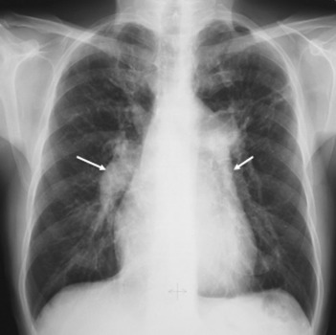
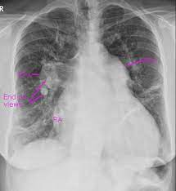
P. Hypertension
Severe P. Hypertension

Slide 13
THANK YOU

